Slide 1

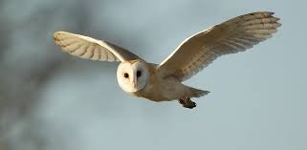
Welcome to Owls Class!
2024 - 2025

Slide 2
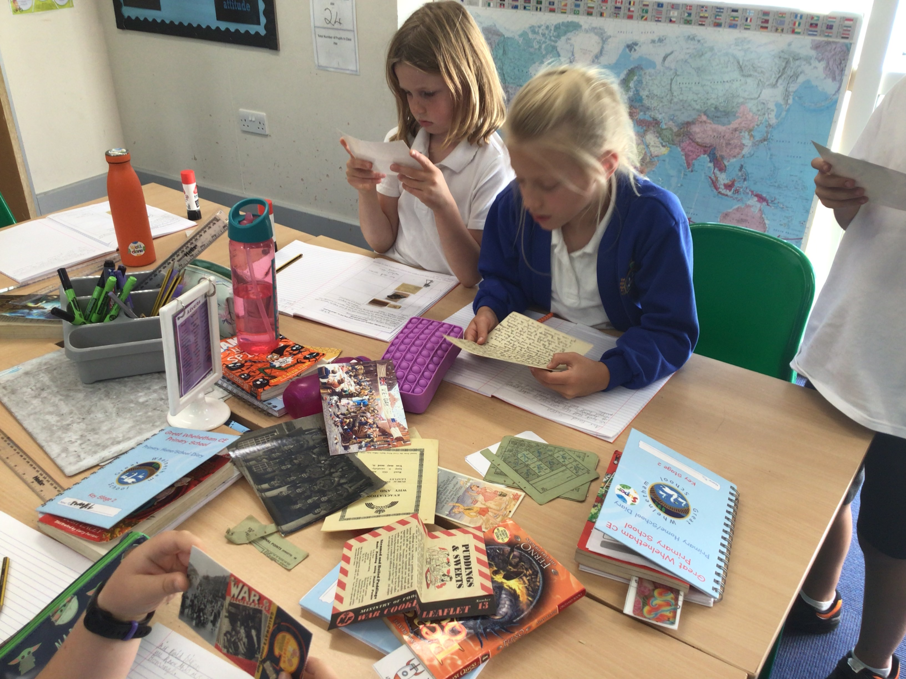
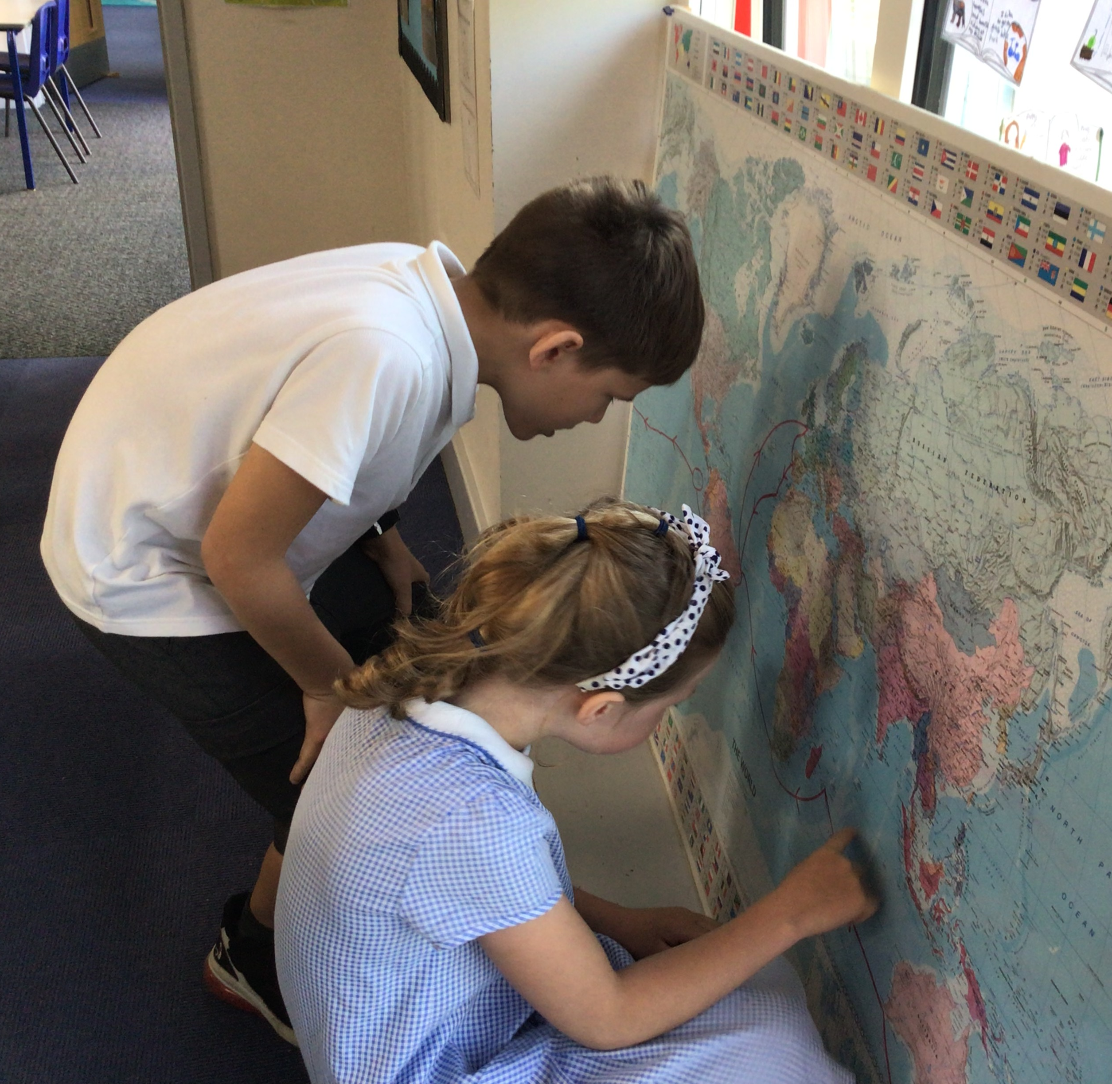
Ethos
Positivity – A love of learning
Resilience
Risk takers (low risk, high reward sessions)
Enthusiastic learners – high quality foundation subjects
Learning habits - BLP muscles
Wellbeing

Slide 3
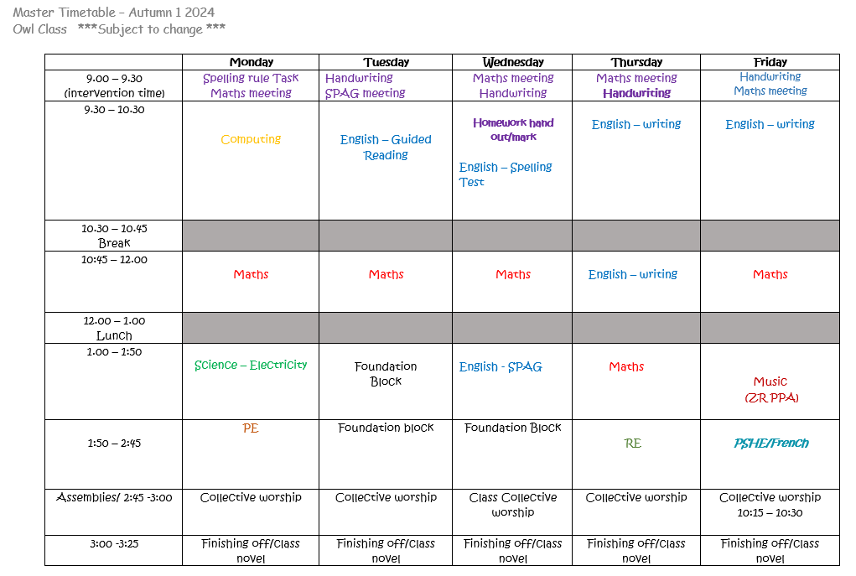
Time Table

Slide 4
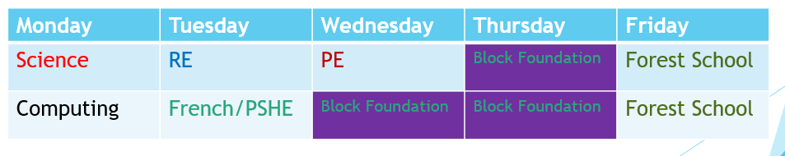
Time Table
English and maths is taught every morning.
The children will be taught by Mrs Reavis on a Thursday and Friday.
Topic will change every three weeks – this half term we will be completing History (The Blitz) and DT (Savory pastry slice).
We will be looking to start forest schools in Owl class later in the school year but will email you with details nearer the time.
PE = Mondays Music (Cornet) = Fridays
Example timetable to show teaching blocks

Slide 5

Learning in Owl Class
Our curriculum is designed around learning key skills and knowledge
We will learn in lots of different ways – active/practical activities, independent tasks and collaborative tasks
Children will work with partners and in groups as well as independently
We will use ‘Recall’ to check understanding is in our working memory. This is how we begin every lesson.

Slide 6
Assessment
Children’s work in books will be marked and feedback/next steps will be given
Verbal feedback will be given within lessons
Children will complete a maths, reading and SPaG assessment at the end of each term (December, March, June)
Children will complete independent writing tasks throughout the year which will be assessed
The assessments above will give us an indication of whether your child is working towards the expected level, at the expected level or at a greater depth level in each subject
Year 4 Complete an online multiplication check in the Summer Term – statutory

Slide 7

Homework
Spellings – these will be given out and tested on a Wednesday. We will spend time in class learning the spelling rule and practising the words, however, it is expected that the children practise these at home too.
Reading – your child should have a reading book which they should be reading at home and should be brought into school each day. We expect the children to be reading 3 times a week at home. This can be for just for 10-15 minutes. Your child can write in their reading record the book/pages that they have read and we ask that an adult please signs this. Their reading records will be checked on a Thursday.

Slide 8

Homework continued…
English/Maths – the children will be set Spelling and maths homework on a Wednesday and this is due in the following Wednesday. Their homework should be completed in their homework books. The maths homework will follow a similar pattern to our white Rose maths booklets; reviewing prior learning and then practising the maths work that we have covered that week.
Mrs Reavis = English – Thursday/Thursday – work to enhance current English unit
Each week
1 x spelling list
1 x maths homework
1 x English task linked to class work (Mrs Reavis)

Slide 9


Other Home learning tools – coming soon
Purple mash = computing curriculum as well as fun games for other areas of the curriculum (maths, science, English, History etc)
Summdog = maths challenges and games to engage pupils and practice key skills.
Pupils will have login details for these websites – we are creating stickers with all the details for their planners.

Slide 10

Home School Agreement

Slide 11

Throughout the year, if you have any questions, concerns or would like to discuss any matters, please telephone the school to arrange a phone call or email us on the address below.
b.varela@greatwhelnethamprimary.org.uk
z.reavis@greatwhelnethamprimary.org.uk
*Planners – communication*

