Slide 1
Welcome to Swans Class!
2024 - 2025

Slide 2
Time Table
English and Maths are taught every morning.
Foundation subject Topics will change every three weeks – this half term we will be learning History (The Maya) and Design and Technology (Bread Making).
Swans will have Forest Schools later this year, but not this term.
PE lesson is on Monday afternoon with Ipswich Town FC coaches and there is lunchtime PE on Monday and Friday.

Slide 3
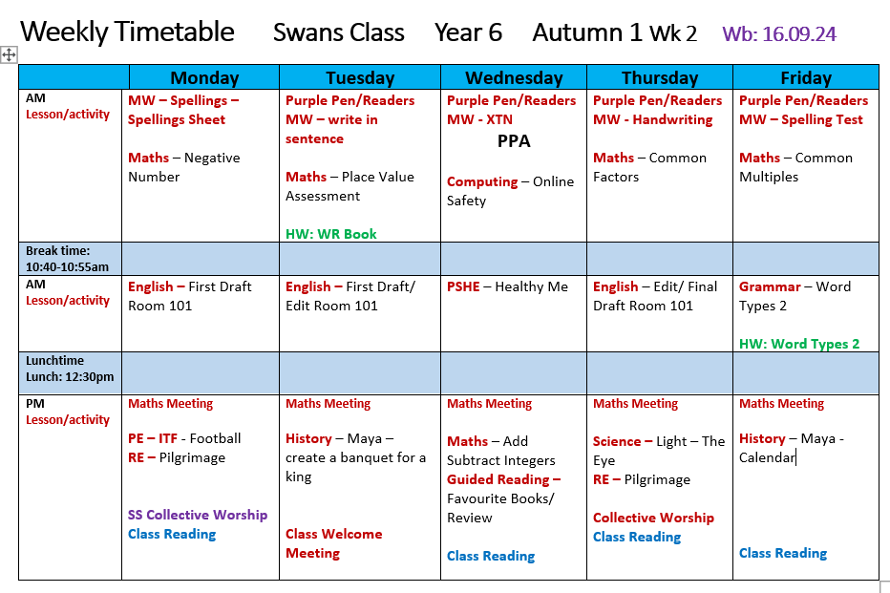

Slide 4
Learning in Swans Class
Our curriculum is designed around learning key skills and knowledge
We will learn in lots of different ways – active/practical activities, independent tasks and collaborative tasks
Children will work with partners and in groups as well as independently – our smaller class this year lends itself to this particularly well.

Slide 5
The Home-School Agreement
As a School we will:
Provide a safe, happy, nurturing environment where all children are valued, respected, and listened to.
Provide excellent teaching and an engaging curriculum to meet the needs of all children.
Provide opportunities for your child to practise what they have learnt in school at home.
Regularly share updates on children’s progress and experiences in school through parent consultations, class newsletters, website updates, share days and more.
Support your child to develop a moral and ethical compass for life enabling them to grow up to be the best person they can be through a values -based education philosophy.
Provide opportunities for children to develop positive, social relationships, self-esteem and a sense of responsibility.
Respect confidentiality of information regarding each child.
Provide information to you about our school, including relevant policies, meetings, workshops, and events by keeping our website up-to-date, emailing information, sharing regular school newsletters and updating our calendar of events.
Build positive relationships with pupils, families and the wider community.
Signed:____________________

Slide 6
The Home-School Agreement
As a Parent/Carer I will:
• Ensure that my child attends school regularly, arrives on time and is wearing school uniform and with the proper equipment.
• Let the school know of any concerns or worries that may be affecting my child’s learning, behaviour or ability to do home learning so we can support and resolve quickly.
• Attend meetings with my child’s teacher and other staff, aiming to be positive and productive, working together to move my child on in their learning.
• Respect the confidentiality of each child
• Support and work with the school to ensure that the behaviour policies we use to enhance positive relationships are maintained.
• Regularly read information on the website, check the online calendar and read updates so I am kept up-to-date with important details of relevant policies, meetings, events and information about my child.
• Ensure the school has up to date emergency contact numbers.
• Support my child to try their best with their home learning.
Signed: _________________________

Slide 7
The Home-School Agreement
As a pupil I will:
• Come to school regularly and on time.
• Wear school uniform (or PE kit on appropriate days).
• Behave in a safe and friendly way following our 3 golden rules
• Be polite, helpful and respectful to everyone in school.
• Take an active role in my learning – engaging with new experiences and challenges in a positive way.
• Take care of equipment, the building and school grounds
• Use the internet safely and responsibly in school and at home.
• Reflect on my choices and learn from all my experiences.
• Tell a member of staff if I am worried or unhappy.
• Try my best with home learning and return it to school at the correct time. Signed:______________________

Slide 8
Homework
Spellings – these will be given out on a Friday. We will spend time in class learning the spelling rule and practising the words. However, it is expected that the children practise these at home too, using Spelling Shed if they want to. The children will be tested on a Friday (their score will be written in their reading record).
Reading – your child should have a reading book which they are reading at home and should be brought into school each day with their Planner. We expect the children to be reading 4-5 times a week at home. This should be for around 20 minutes each day.
Reading fluency and vocabulary help with every subject and is the cornerstone of a child’s learning.
Your child can write in their reading record the book/pages that they have read and we ask that an adult please signs this at the end of the week. Their reading records will be checked on a Monday or Tuesday for the previous week.

Slide 9
Homework continued…
Maths – the children will be set Maths homework on a Tuesday and this is due in on Thursday of the same week.
The Maths homework will be in the White Rose workbooks – please engage with these to understand better the way we teach Maths so you can support your child with their learning.

Slide 10
Homework continued…
English – the children will be set English homework on a Friday and this is due in on Tuesday of the following week. This can be completed either at the weekend or on a Monday if your child has had a busy weekend.
The English homework will vary between SPaG, reading comprehension and writing tasks.

Slide 11
Homework continued…
Times Tables – in Year 6 the children are expected to know their Times Tables up to 12, by heart.
These are boring and hard work, but they only ever have to learn them once!
They are vital to all aspects of our Maths work and it is no exaggeration to say that they are essential for a good result in SATs.
Try Hit the Button (free) or Times Tables Rockstars (£7 per year)
https://www.topmarks.co.uk/maths-games/hit-the-button

Slide 12
Homework continued…
Homework Projects – these are set some half terms and not others.
They are a separate project to work on in children’s spare time
They will be craft based or usually some other practical activity such as photography
There will be 2-3 over the year

Slide 13
Assessment
Children’s work in books will be marked and feedback/next steps will be given.
Verbal feedback will be given within lessons.
Children will complete a SATs level Maths, Reading and SPaG assessment at the end of each term (December and March).
Children will complete independent writing tasks throughout the year which will be assessed against government criteria.
These assessments will give us a clear indication of whether your child is working towards the expected level, at the expected level or at a greater depth level in each subject, giving a good projection of how they are likely to do in the SATs.
SATs will take place for all Year 6 children in the week of May 12th 2025
There are 3 Maths papers, 1 Reading paper, 1 SPaG and 1 Spellings test.
Any questions about the SATs?

Slide 14
Apply for a High School Place
The deadline to apply is October 31st 2024
You should have received a letter with details of what to do

Slide 15
Throughout the year, if you have any questions, concerns or would like to discuss any matters, please see me at the door, telephone the school to arrange a phone call or email me on the address below.
s.sharp@greatwhelnethamprimary.org.uk
Any further questions?

